Slide 1
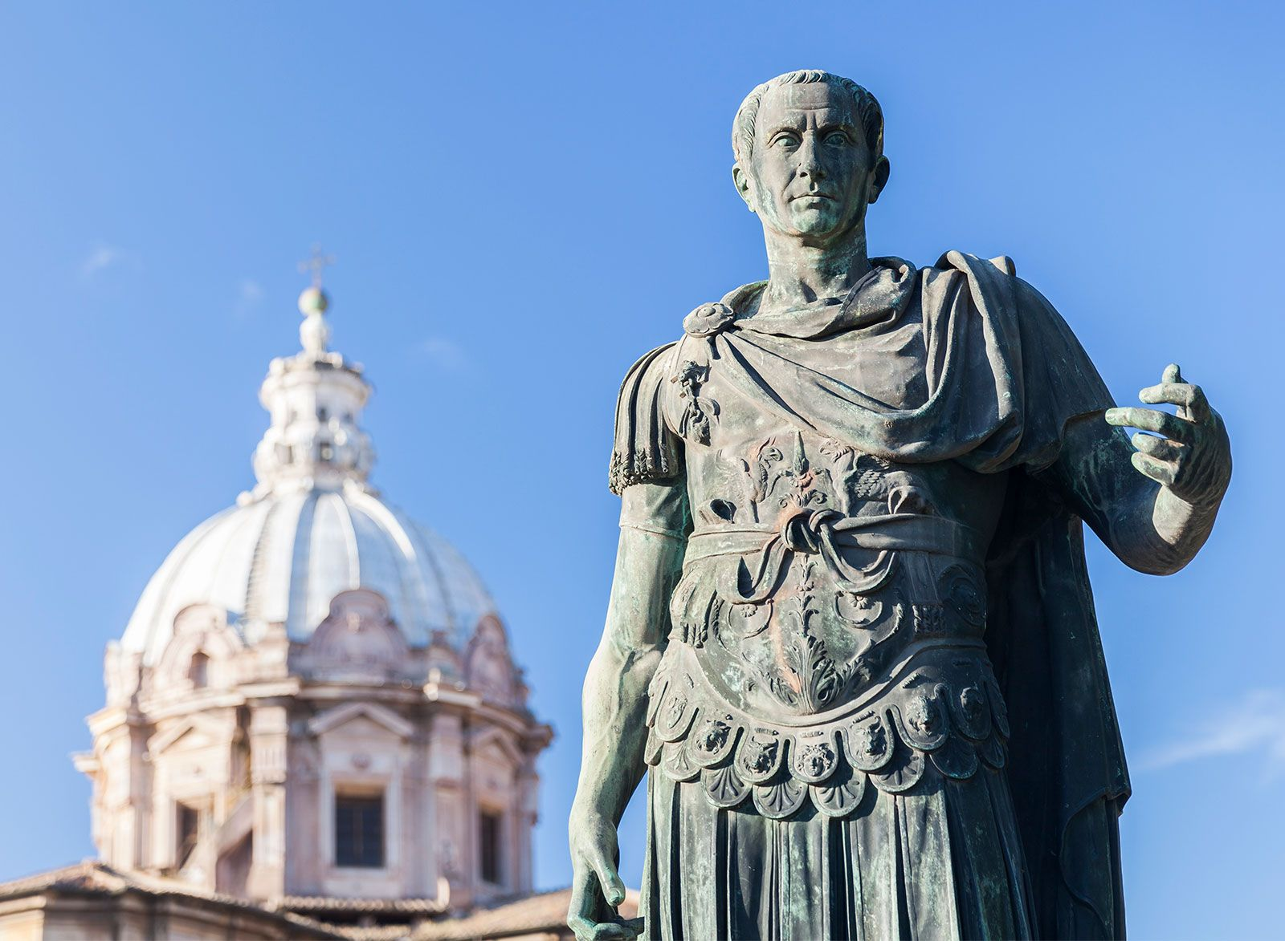
Julius Caesar
- Identify the features and influences of JC’s Early Life
Week 6 Lesson 1
Ms Barrie

Slide 2
Key Information – Julius Caesar
Born 12/13 July 100 BCE, Rome (Italy)
Roman general and statesman
Conquered Gaul (58 – 50BCE)
Victor in civil War (49 – 45BCE)
Dictator (46 – 44BCE)
Launched a series of pol and soc reforms when he was assassinated by a group of nobles
in the Senate House on the Ides of March
Changed the course of history

Slide 3

Video
Julius Caesar
https://www.youtube.com/watch?v=Z1NimVSJ8XI

Slide 4
Today’s Lesson
Early life/family background

Slide 5
ACTIVITY – Key people/events/ideas
Read through the information sheet and categorise key people, events, and ideas into the table provided
ALSO write down any key roles that Caesar held
Use dot-points only

Slide 6

WHITEBOARD QUIZ
Get a whiteboard, marker, and cloth
1 between two OR individual

Slide 7
What are the names of Caesar’s parents?
Write it on your whiteboard
HOVER WHEN COMPLETE
Notes:
Gaius Caesar and Aurelia

Slide 8
In what year did Caesar cross the Rubicon?
Write it on your whiteboard
HOVER WHEN COMPLETE
Notes:
49 BCE

Slide 9
Who did Caesar marry in 84 BCE?
Write it on your whiteboard
HOVER WHEN COMPLETE
Notes:
Cornelia – daughter of Lucius Cornelia Cinna

Slide 10
Who ordered Caesar to divorce his wife?
Write it on your whiteboard
HOVER WHEN COMPLETE
Notes:
Lucius Cornelia Sulla (SULLA)

Slide 11
Who was Caesar captured by?
Write it on your whiteboard
HOVER WHEN COMPLETE
Notes:
Pirates

Slide 12
What is the first role on the Roman political ladder? Caesar was elected to this role in 69 or 68 BCE
Write it on your whiteboard
HOVER WHEN COMPLETE
Notes:
Quaestor

Slide 13
Who was Caesar’s second wife?
Write it on your whiteboard
HOVER WHEN COMPLETE
Notes:
Pompeia

Slide 14
Caesar was elected Praetor in what year?
Write it on your whiteboard
HOVER WHEN COMPLETE
Notes:
62 BCE

